Slide 1
Chapter 3: Process Concept

Slide 2
Chapter 3: Processes
Process Concept
Process Scheduling
Operations on Processes
Interprocess Communication
Examples of IPC Systems
Communication in Client-Server Systems

Slide 3
Objectives
To introduce the notion of a process -- a program in execution, which forms the basis of all computation
To describe the various features of processes, including scheduling, creation and termination, and communication
To describe communication in client-server systems

Slide 4
Process Concept
An operating system executes a variety of programs:
  Batch system – jobs
  Time-shared systems – user programs or tasks
Textbook uses the terms job and process almost interchangeably
Process – a program in execution; process execution must progress in sequential fashion
A process includes:
  program counter
  stack
  data section

Slide 5

Process in Memory

Slide 6
Process State
As a process executes, it changes state
  new: The process is being created
  running: Instructions are being executed
  waiting: The process is waiting for some event to occur
  ready: The process is waiting to be assigned to a processor
  terminated: The process has finished execution

Slide 7

Diagram of Process State

Slide 8
Process Control Block (PCB)
Information associated with each process
Process state
Program counter
CPU registers
CPU scheduling information
Memory-management information
Accounting information
I/O status information

Slide 9

Process Control Block (PCB)

Slide 10

CPU Switch From Process to Process

Slide 11
Process Scheduling Queues
Job queue – set of all processes in the system
Ready queue – set of all processes residing in main memory, ready and waiting to execute
Device queues – set of processes waiting for an I/O device
Processes migrate among the various queues

Slide 12

Ready Queue And Various I/O Device Queues

Slide 13
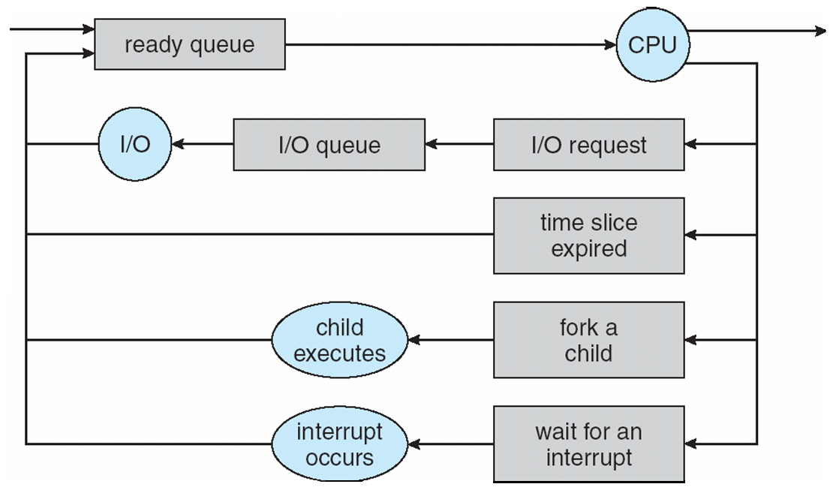
Representation of Process Scheduling

Slide 14
Schedulers
Long-term scheduler (or job scheduler) – selects which processes should be brought into the ready queue
Short-term scheduler (or CPU scheduler) – selects which process should be executed next and allocates CPU

Slide 15

Addition of Medium Term Scheduling

Slide 16
Schedulers (Cont)
Short-term scheduler is invoked very frequently (milliseconds) ⇒ (must be fast)
Long-term scheduler is invoked very infrequently (seconds, minutes) ⇒ (may be slow)
The long-term scheduler controls the degree of multiprogramming
Processes can be described as either:
  I/O-bound process – spends more time doing I/O than computations, many short CPU bursts
  CPU-bound process – spends more time doing computations; few very long CPU bursts

Slide 17
Process Creation
Init process is the first process created by operating system after booting with the process ID 1.
fork() system call is used to create a new process
Fork() clones the process. Creates exact copy of a process with a new process ID.

Slide 18
Fork
When a fork system is called operating system does the following:
Check maximum number of processes a user can create.
Check available resources
Create new PCB
Assign new PID to child process
Copy parent PCB to child PCB
Put the process in ‘Created’ state (Admitted to job queue)
Increment counts on current directory and open files
Copy memory map and context of parent process into child process(set Copy on Write (COW))
Set child state to ‘ready’
Wait for the scheduler to run the process.
Notes:
Copy On Write. Operating system tells the hardware that whenever this portion of area (which is shared between the parent and child) is to be written, creates its noew copy.
Writing on any location of memory is not dependent on Operating System. It is a user space function and kernel is not involved in this operation. Hence operating system set this mechanism that whenever this area of memory is to written, it should be protected and two copies of it must be created.
Copy on Write is a hardware mechanism and cannot be implemented with software.
Operating system maintains track of all the open files, how many processes are using a particular file or particular resource. When a child process is created, this record is updated.
Parent process will be executed now or child, it is not mendatory, it depnds on scheduler. The process selected by a scheduler is executed first.
If fork() returns -1 it means that there is an error in the process creation. If fork returns ‘0’ it means that the child process has been successfully created.
Fork() is used to create a copy of parent process, exec() is used to replace the currently executing process with a new process.

Slide 19
Exec System Call
Replaces the currently running (Calling) process.
Process image of calling process is replaced with the new process.
Does not return anything
Idea: Fork the init and then exec in the child.
Procedure to create a process is, fork the and then exec in child.

Slide 20
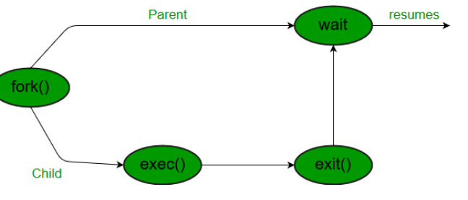
Exit System Call
It simply terminates the execution of a process.

Slide 21
Context Switch
When CPU switches to another process, the system must save the state of the old process and load the saved state for the new process via a context switch
Context of a process represented in the PCB
Context-switch time is overhead; the system does no useful work while switching
Time dependent on hardware support

Slide 22
Interprocess Communication
Processes within a system may be independent or cooperating
Cooperating process can affect or be affected by other processes, including sharing data
Reasons for cooperating processes:
  Information sharing
  Computation speedup
  Modularity
  Convenience
Cooperating processes need interprocess communication (IPC)
Two models of IPC
  Shared memory
  Message passing
Notes:
Message passing is implemented at kernel level. A process which wants to communicate with another process first sends a message to the kernel, kernel sends that message to the recipient process. It involve mode switch and results in a procedural call hence this communication process takes lots of time.
Shared memory communication is faster than message passing.

Slide 23

Communications Models

Slide 24
Producer-Consumer Problem
Paradigm for cooperating processes, producer process produces information that is consumed by a consumer process
  unbounded-buffer places no practical limit on the size of the buffer
  bounded-buffer assumes that there is a fixed buffer size
Notes:
Process synchronization issue

Slide 25
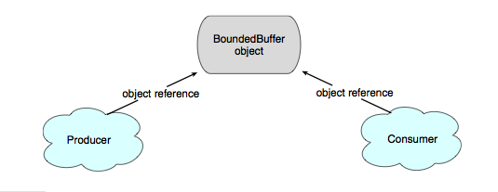
Simulating Shared Memory in Java

Slide 26
Producer
Consumer
Initially in = out = 0;
while (true)
{
while (count == 0)
; // do nothing
nextConsumed = buffer[out];
out = (out + 1) % BUFFER_SIZE;
count--;
/* consume the item in nextConsumed */
}
while (true)
{
/* produce an item and put in nextProduced */
while (count == BUFFER_SIZE)
; // do nothing
buffer [in] = nextProduced;
in = (in + 1) % BUFFER_SIZE;
count++;
}

Slide 27
Interprocess Communication – Message Passing
Mechanism for processes to communicate and to synchronize their actions
Message system – processes communicate with each other without resorting (accomplishing something) to shared variables (without sharing the same address space)
IPC facility provides two operations:
  send(message) – message size fixed or variable
  receive(message)
If P and Q wish to communicate, they need to:
  establish a communication link between them
  exchange messages via send/receive
Implementation of communication link
  physical (e.g., shared memory, hardware bus)
  logical (e.g., logical properties such buffering at programming level)

Slide 28
Implementation Questions
How are links established?
Can a link be associated with more than two processes?
How many links can there be between every pair of communicating processes?
What is the capacity of a link?
Is the size of a message that the link can accommodate fixed or variable?
Is a link unidirectional or bi-directional?

Slide 29
Direct Communication
Processes must name each other explicitly:
  send (P, message) – send a message to process P
  receive(Q, message) – receive a message from process Q
Properties of communication link
  Links are established automatically
  A link is associated with exactly one pair of communicating processes
  Between each pair there exists exactly one link
  The link may be unidirectional, but is usually bi-directional

Slide 30
Indirect Communication
Messages are directed and received from mailboxes (also referred to as ports, abstractly viewed as Object)
  Each mailbox has a unique id
  Processes can communicate only if they share a mailbox
Properties of communication link
  Link established only if processes share a common mailbox
  A link may be associated with many processes
  Each pair of processes may share several communication links
  Link may be unidirectional or bi-directional

Slide 31
Indirect Communication
Operations
  create a new mailbox
  send and receive messages through mailbox
  destroy a mailbox
Primitives are defined as:
send(A, message) – send a message to mailbox A
receive(A, message) – receive a message from mailbox A

Slide 32
Indirect Communication
Mailbox sharing
  P₁, P₂, and P₃ share mailbox A
  P₁, sends; P₂ and P₃ receive
  Who gets the message?
Solutions
  Allow a link to be associated with at most two processes
  Allow only one process at a time to execute a receive operation
  Allow the system to select arbitrarily the receiver. Sender is notified who the receiver was.

Slide 33
Synchronization
Message passing may be either blocking or non-blocking
Blocking is considered synchronous
  Blocking send has the sender block until the message is received
  Blocking receive has the receiver block until a message is available
Non-blocking is considered asynchronous
  Non-blocking send has the sender send the message and continue
  Non-blocking receive has the receiver receive a valid message or null

Slide 34
Buffering
Queue of messages attached to the link; implemented in one of three ways
  1. Zero capacity – 0 messages
  Sender must wait for receiver (rendezvous)
  2. Bounded capacity – finite length of n messages
  Sender must wait if link full
  3. Unbounded capacity – infinite length
  Sender never waits

Slide 35
Examples of IPC Systems - POSIX
POSIX Shared Memory
  Process first creates shared memory segment
  segment id = shmget(IPC PRIVATE, size, S IRUSR | S IWUSR);
  Process wanting access to that shared memory must attach to it
  shared memory = (char *) shmat(id, NULL, 0);
  Now the process could write to the shared memory
  sprintf(shared memory, "Writing to shared memory");
  When done a process can detach the shared memory from its address space
  shmdt(shared memory);

Slide 36
Examples of IPC Systems - Mach
Mach communication is message based
  Even system calls are messages
  Each task gets two mailboxes at creation- Kernel and Notify
  Only three system calls needed for message transfer
  msg_send(), msg_receive(), msg_rpc()
  Mailboxes needed for commuication, created via
  port_allocate()

Slide 37
Examples of IPC Systems – Windows XP
Message-passing centric via local procedure call (LPC) facility
  Only works between processes on the same system
  Uses ports (like mailboxes) to establish and maintain communication channels
  Communication works as follows:
    The client opens a handle to the subsystem’s connection port object
    The client sends a connection request
    The server creates two private communication ports and returns the handle to one of them to the client
    The client and server use the corresponding port handle to send messages or callbacks and to listen for replies

Slide 38

Local Procedure Calls in Windows XP

Slide 39
Communications in Client-Server Systems
Sockets
Remote Procedure Calls
Remote Method Invocation (Java)

Slide 40
Sockets
A socket is defined as an endpoint for communication
Concatenation of IP address and port
The socket 161.25.19.8:1625 refers to port 1625 on host 161.25.19.8
Communication consists between a pair of sockets

Slide 41

Socket Communication

Slide 42
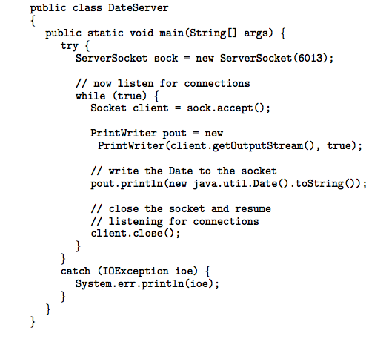
Socket Communication in Java

Slide 43
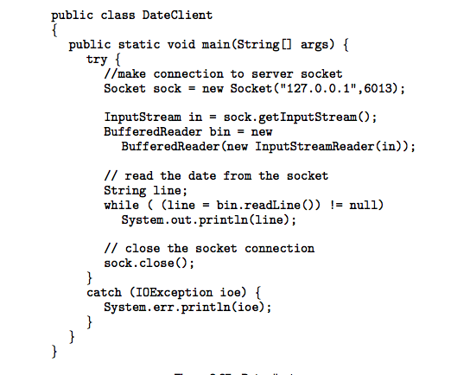
Socket Communication in Java

Slide 44
Remote Procedure Calls
Remote procedure call (RPC) abstracts procedure calls between processes on networked systems
Stubs – client-side proxy for the actual procedure on the server
The client-side stub locates the server and marshalls the parameters
The server-side stub receives this message, unpacks the marshalled parameters, and performs the procedure on the server

Slide 45
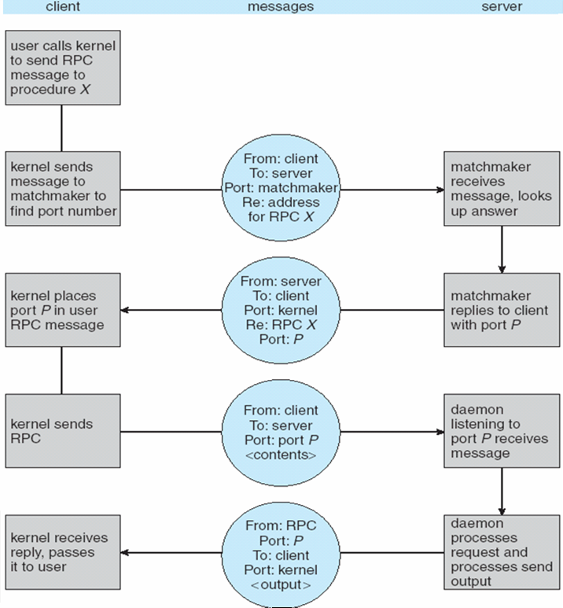
Execution of RPC

Slide 46
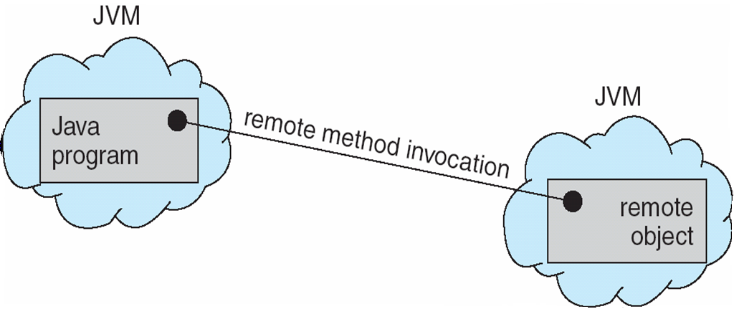
Remote Method Invocation
Remote Method Invocation (RMI) is a Java mechanism similar to RPCs
RMI allows a Java program on one machine to invoke a method on a remote object

Slide 47
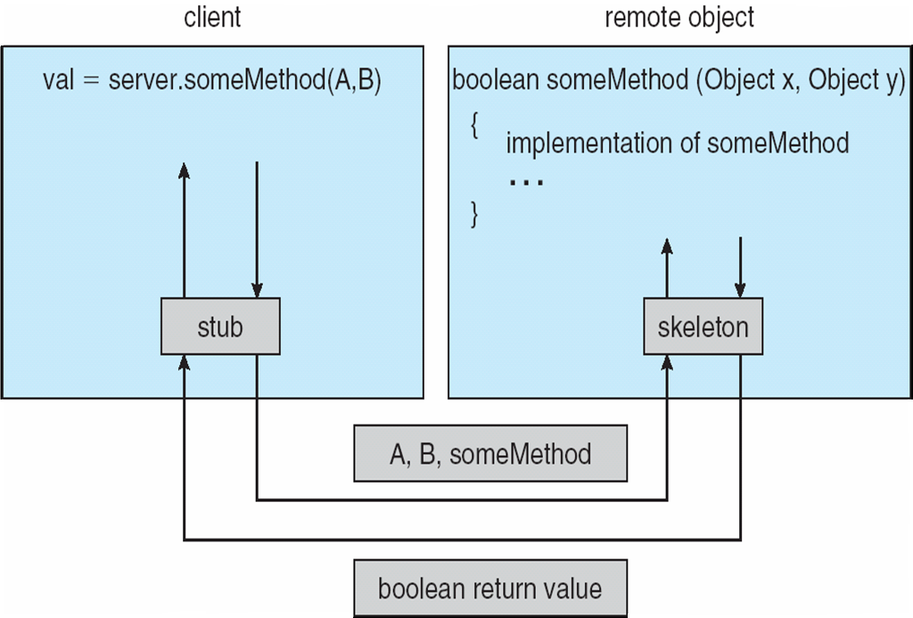
Marshalling Parameters

Slide 48

RMI Example

Slide 49
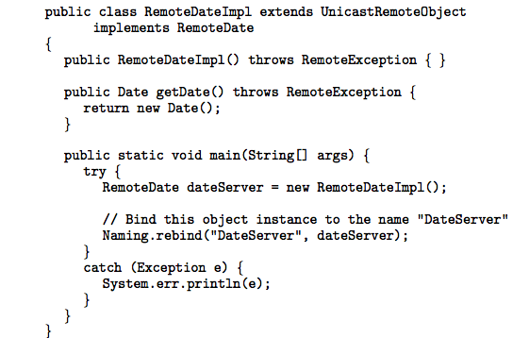
RMI Example

Slide 50
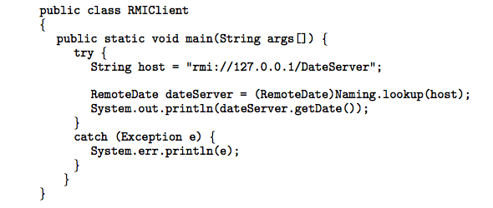
RMI Example

Slide 51
End of Chapter 3

